Slide 1

Eletric-go
by PentaXLastdance

Slide 2
01
02
03
Problem
Solution
Success & Benefits
Presentation contents
Customer needs
How our product addresses their needs
What success will look as a result of using our product

Slide 3
Problem
01
Custom needs

Slide 4
Custom needs!
Development of a prototype for a delivery distribution planning system between warehouses using a fleet of electric vehicles
The prototype consists of the following modules:
• Warehouse Management
• Logistics
• Distribution planning

Slide 5
Solution
02
How our product addresses their needs

Slide 6

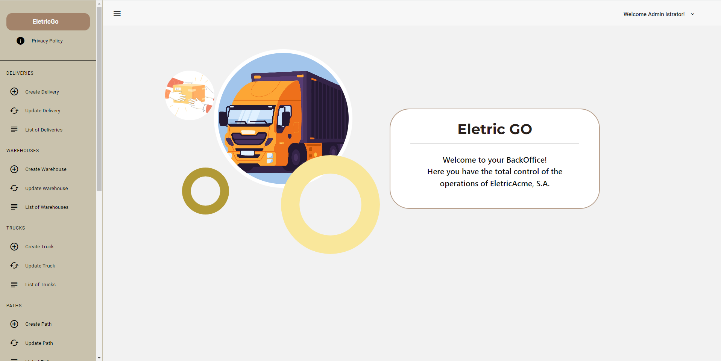
Let's start our practical presentation !

Slide 7
Success & Benefits
03
What success will look as a result of using our product

Slide 8
Final Result
Appealing Design
Intuitive
Easy to adding new features
Extra Features

Slide 9
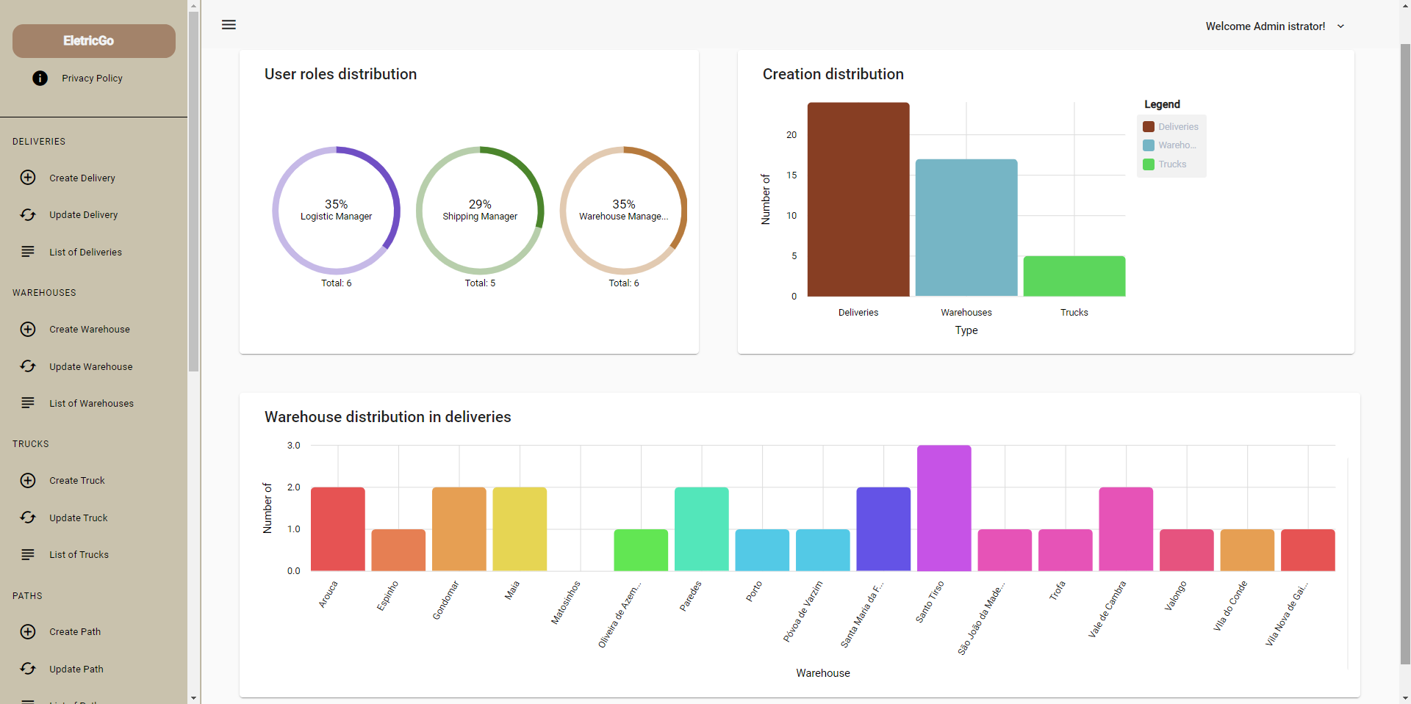
Dataview (extra feature)
Global Control Panel for Administrator

Slide 10
THANK YOU!
PentaXLastdance

Slide 11

Presentation of evidence according to the defined criteria

Slide 12
Planning/Preparation
Factor 1
Factor 2

Slide 13
Burndown chart
Venus has a beautiful name and is the second planet from the Sun

Slide 14
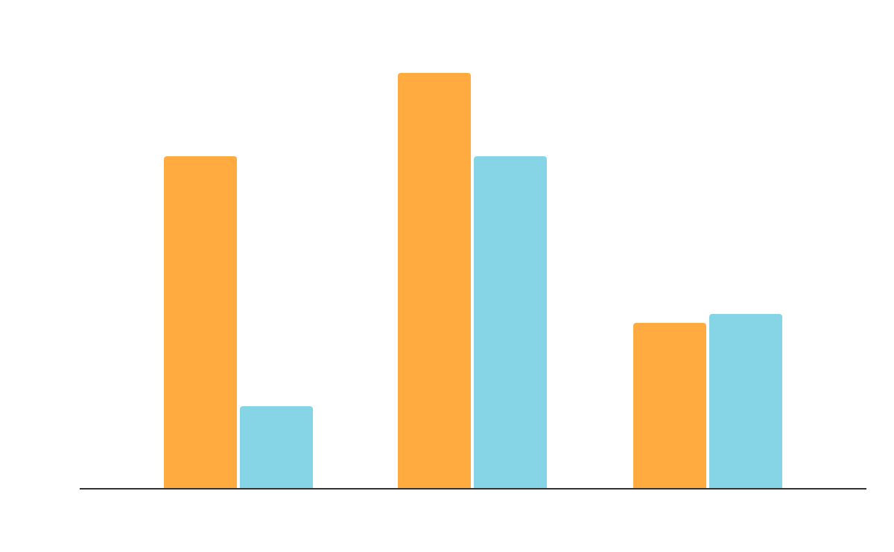
Retrospective
Factor 1
Factor 2
To modify this graph, click on it, follow the link, change the data and replace it

Slide 15
Processo engenharia de Software
15%
40%
20%
25%
Factor 1
Factor 2
Factor 3
Factor 4

Slide 16
Coerência e integração da solução
MERCURY
VENUS
MARS
JUPITER
SATURN
NEPTUNE
Mercury is the smallest planet
Venus has a
beautiful name
Mars is actually a cold place
It’s a gas giant and the biggest one
Saturn is the ringed one and a gas giant
It’s the farthest planet from the Sun

Slide 17
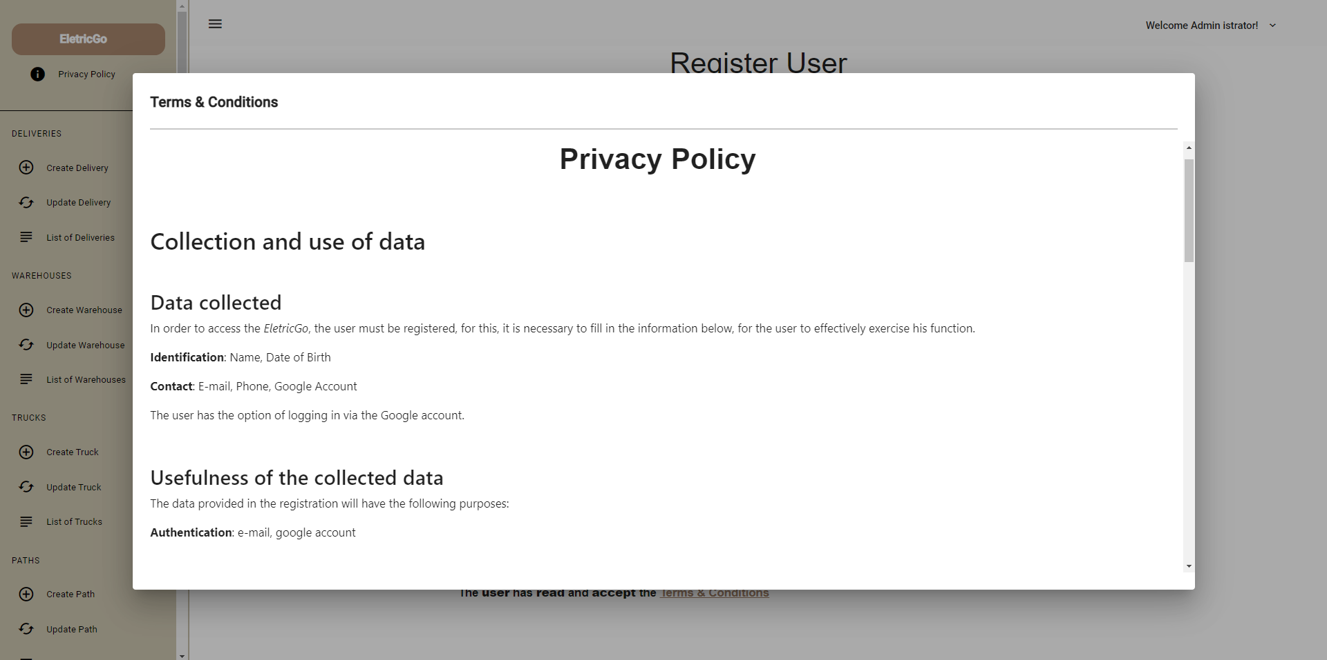
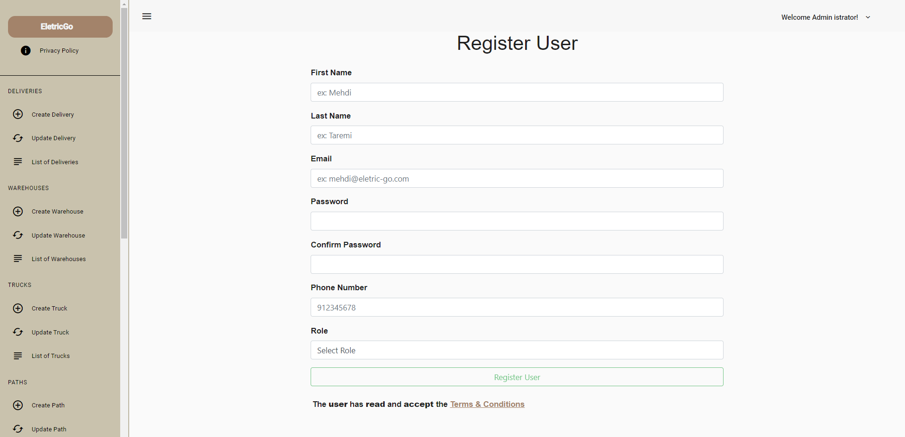
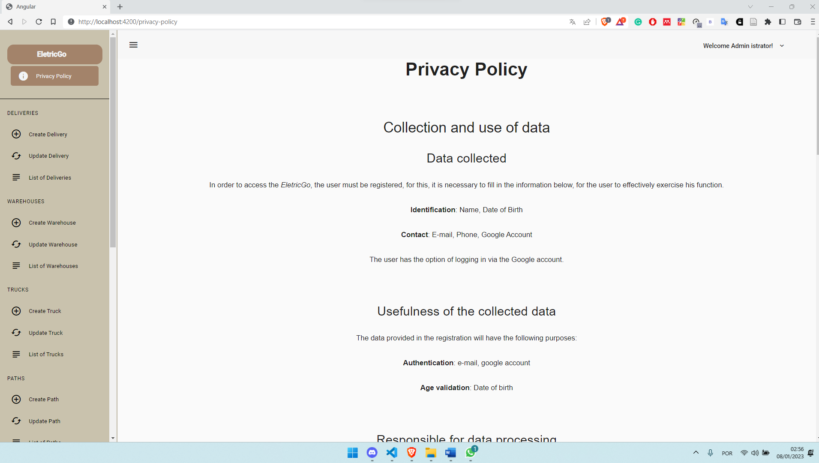
Identificação de requisitos RGPD & Âmbito funcional RGPD
All users have access to the privacy policy!

Slide 18
THANK YOU!
PentaXLastdance

